Slide 1
Economic Inequality
Roger White, Ph.D.
Professor and Douglas W. Ferguson Chair of
International Economics, Whittier College
Osher Lifelong Learning Institute
Eckerd College
October 24, 2023

Slide 2
National Economic Education Delegation
Vision
One day, the public discussion of policy issues will be grounded in an accurate perception of the underlying economic principles and data.
Mission
NEED unites the skills and knowledge of a vast network of professional economists to promote understanding of the economics of policy issues in the United States.
NEED Presentations
Are nonpartisan and intended to reflect the consensus of the economics profession.

Slide 3
Who Are We?
Honorary Board: 54 members
2 Fed Chairs: Janet Yellen, Ben Bernanke
6 Chairs Council of Economic Advisers
Furman (D), Rosen (R), Bernanke (R), Yellen (D), Tyson (D), Goolsbee (D)
3 Nobel Prize Winners
Akerlof, Smith, Maskin
Delegates: 652+ members
At all levels of academia and some in government service
All have a Ph.D. in economics
Crowdsource slide decks
Give presentations
Global Partners: 49 Ph.D. Economists
Aid in slide deck development

Slide 4
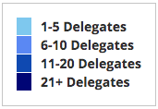
Where Are We?

Slide 5
Credits and Disclaimer
This slide deck was authored by:
Jon Haveman, Executive Director of NEED
This slide deck was reviewed by:
Timothy Smeeding, University of Wisconsin
Robert Wright, Augustana University
Disclaimer
NEED presentations are designed to be nonpartisan
It is, however, inevitable that the presenter will be asked for and will provide their own views
Such views are those of the presenter and not necessarily those of the National Economic Education Delegation (NEED)

Slide 6
Outline
Definition
Forms of inequality
What is the extent of inequality?
What are the sources of inequality?
Why does it matter?
Tension in policy solutions
Brief summary
Q&A

Slide 7
Economic Inequality
Definition:
The extent to which the distribution of income, wealth, or consumption deviates from complete equality
The dispersion of income, wealth, or consumption throughout the economy

Slide 8
Different Ways of Thinking About Inequality
Income Inequality
Before taxes and transfers
After taxes and transfers
Wealth Inequality
Consumption Inequality
How does wealth differ from income?
Income is measured over a period of time, say one year.
Wealth is one’s accumulated savings, including physical and financial assets (net worth).

Slide 9
Recent Facts on Income Inequality
Beginning in the 1970s, the income gap widened.
Income growth in the middle and lower parts of the distribution slowed
Incomes at the top continued to grow strongly
Income shares at the very top of the distribution rose to levels last seen more than 80 years ago
Source: Chad Stone, Danilo Trisi, Arloc Sherman, and Roderick Taylor, “A Guide to Statistics on Historical Trends in Income Inequality,”
Center on Budget and Policy Priorities, Policy Futures, May 15, 2018.

Slide 10
National Income Inequality: Share of Top 10%
Stock Market Crash
WWII
Housing Bubble
Dot-com Bubble

Slide 11
An Abrupt Increase in Inequality
Source: Chad Stone, Danilo Trisi, Arloc Sherman, and Roderick Taylor, “A Guide to Statistics on Historical Trends in Income Inequality,”
Center on Budget and Policy Priorities, Policy Futures, Dec. 11, 2018.
Notes:
Slide taken from page 10, Chad Stone, Danilo Trisi, Arloc Sherman, and Roderick Taylor, “A Guide to Statistics on Historical Trends in Income Inequality,” May 15, 2018

Slide 12
Most of the Action Is at the Top: Pre-Tax
Projected 2021
CBO: Projected Changes in the Distribution of Household Income, 2016 to 2021

Slide 13
Most of the Action Is at the Top: Post-Tax
Projected 2021
CBO: Projected Changes in the Distribution of Household Income, 2016 to 2021

Slide 14
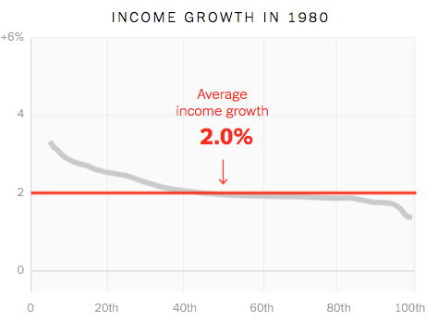
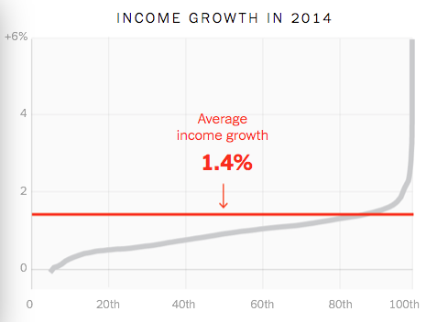
Income Growth Pattern – Has Changed

Slide 15
Income Growth Patterns Have Reversed!
Source: https://www.nytimes.com/interactive/2017/08/07/opinion/leonhardt-income-inequality.html

Slide 16
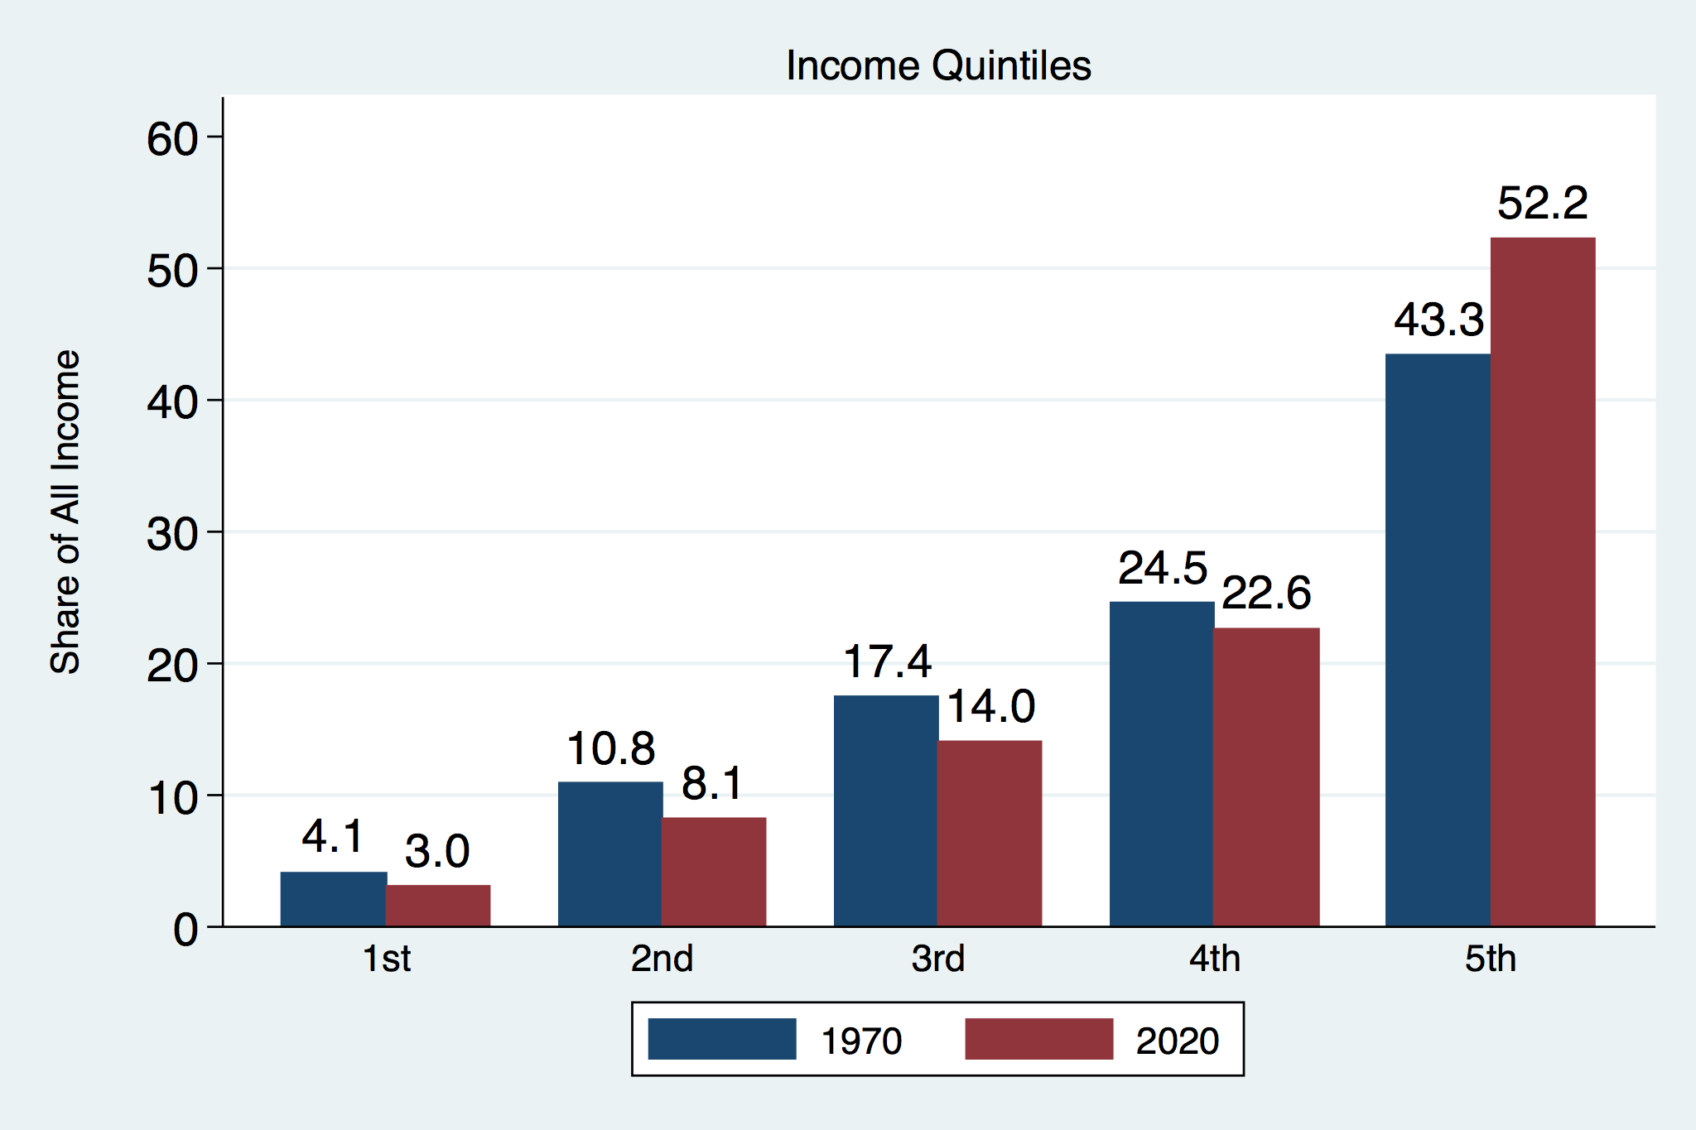
Income Share Changes Between 1970 and 2020
Source: U.S. Census Bureau, Current Population Survey, Annual Social and Economic Supplements.

Slide 17
The Gini Coefficient
100%
A
Gini =
x 100
A + B
50%
Equality (45 degrees)
% of
All Income
A
Bigger A: More inequality
Smaller A: Less inequality
Inequality
B
Extreme
50%
100%
% of Population

Slide 18
Measuring inequality: The Lorenz Curve
Shows the distribution of income in a region
Ex: U.S. Income Distribution - 2008
 | Quintile (2008) | % of total income | Cumulative % of total income
A | Lowest 20% | 3.4 | 3.4
B | Second 20% | 8.6 | 12
C | Middle 20% | 14.7 | 26.7
D | Fourth 20% | 23.3 | 50
E | Highest 20% | 50 | 100

Slide 19
Forming the GINI Coefficient: 2015
U.S. Gini Coefficient in 2015 = 0.482. From 1970 to 2021, it increased from 0.394 to 0.494.
Quintile Shares of Income
CUMULATIVE Quintile Shares of Income
Income Quintiles
Income Quintiles
Source: 2015 1-year American Community Survey, based on pre-tax household income.

Slide 20
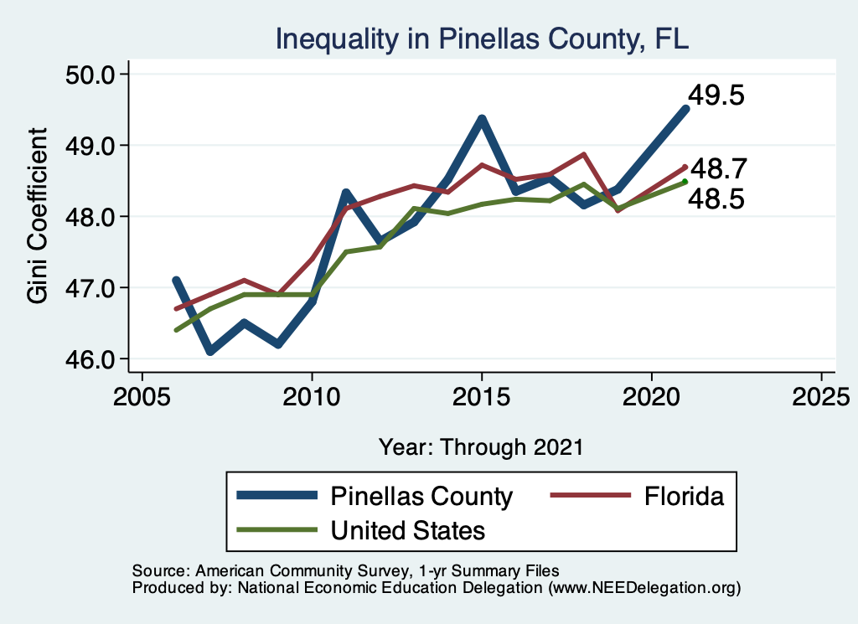
Your Local Inequality Trend

Slide 21
A Second Measure of Inequality: Wealth
Wealth Inequality Exceeds Income Inequality
Source: Chad Stone, Danilo Trisi, Arloc Sherman, and Roderick Taylor, “A Guide to Statistics on Historical Trends in Income Inequality,”
Center on Budget and Policy Priorities, Policy Futures, Dec. 11, 2018.

Slide 22
Wealth Concentration Has Been Rising
2019 Overall Median: $121,700

Slide 23
Wealth is More and More Concentrated
99th Percentile
2016 = 7x 1963
Source: Urban Institute

Slide 24
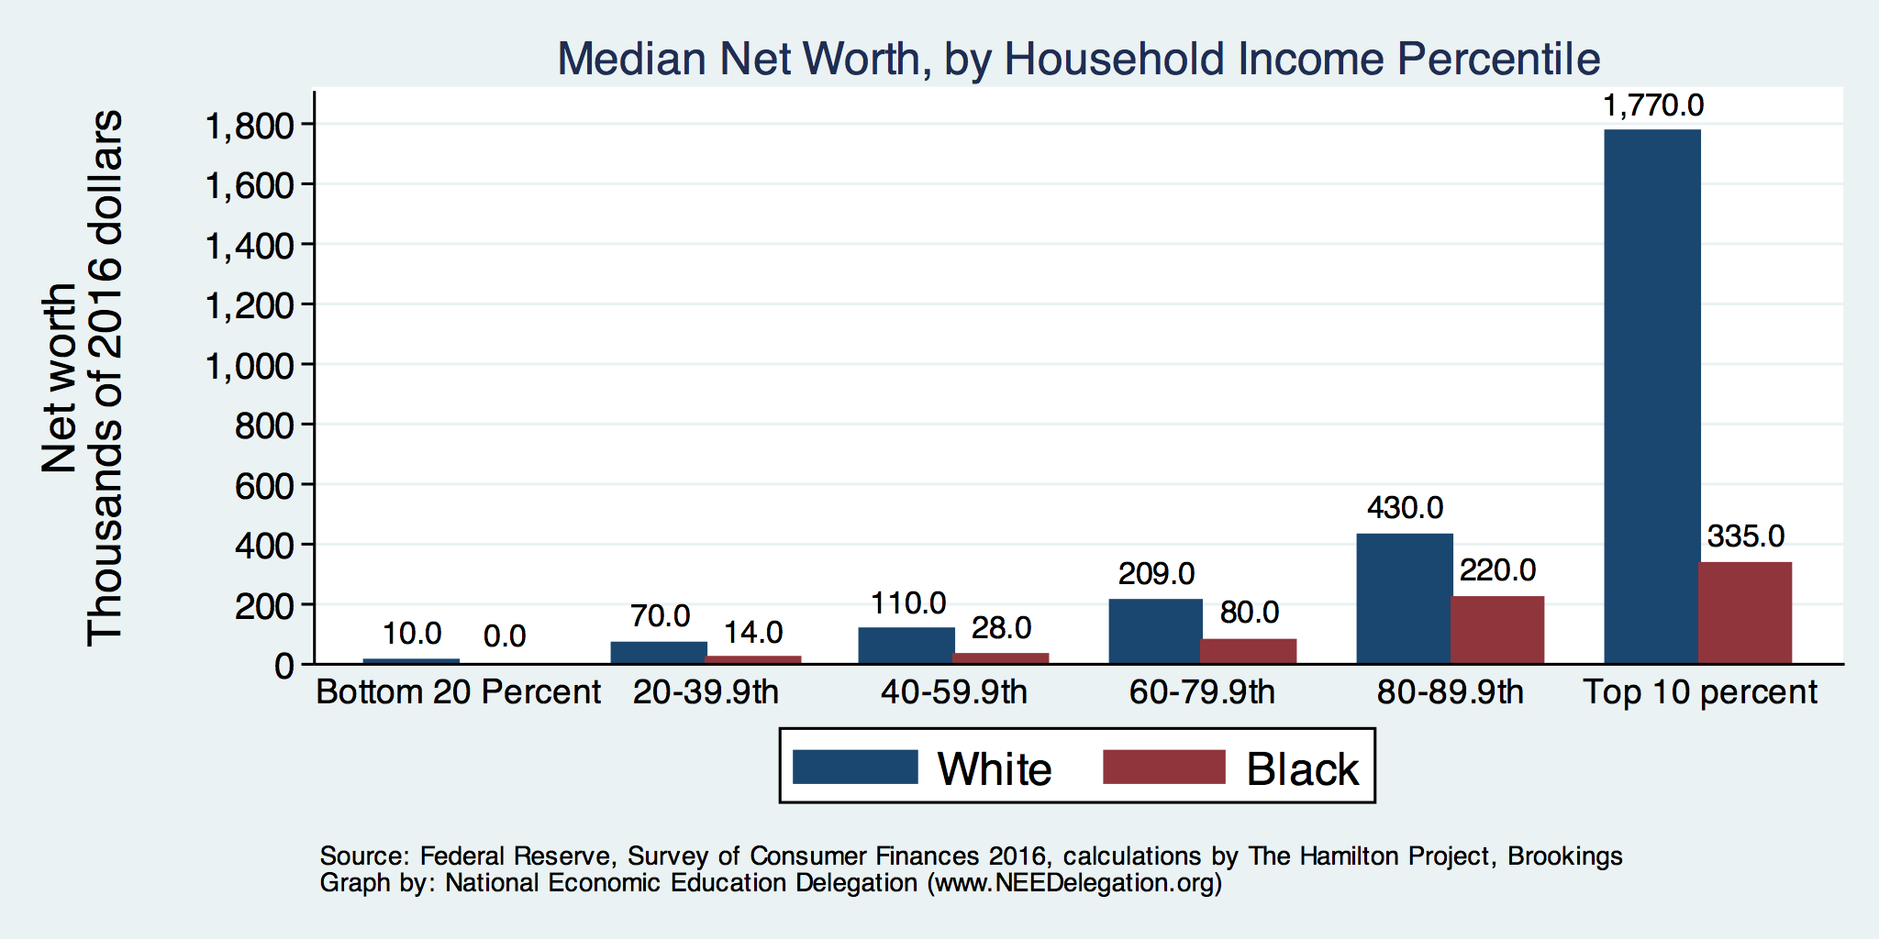
By Household Income

Slide 25
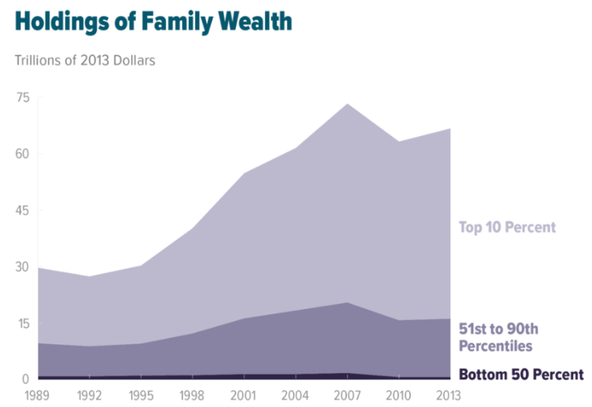
Wealth Gini Coefficient for U.S.
Year | Gini
2008 | 0.801
… | …
2018 | 0.852
2019 | 0.852
2020 | 0.850
Source: "Trends in Family Wealth, 1989 to 2013". Congressional Budget Office.

Slide 26
A Third Measure of Inequality: Consumption
After‐tax Money Income is calculated
as Pre‐tax Money Income plus the value of tax credits such as the EITC, less state and federal income taxes and payroll taxes.
Well‐measured consumption includes spending on food at home, rent (for renters), rental equivalent (for homeowners or those in government or subsidized housing), utilities, service flows from owned vehicles, and spending on gasoline and motor oil.
Source: Meyer, Bruce and James Sullivan (2017) “Consumption and Income Inequality in the U.S. Since the 1960s”, Becker Friedman Institute Working Paper No. 2017-12.

Slide 27
Consumption Inequality
Consumption is another important metric for judging inequality
Arguably a better indicator of “well-being”
Extremely difficult to measure
Growing evidence that consumption inequality has also increased

Slide 28
Growing Evidence: Consumption Inequality
Source: Orazio P. Attanasio and Luigi Pistaferri, “Consumption Inequality,” Journal of Economic Perspectives, Volume 30, #2, Spring 2016, page 11, Figure 1.

Slide 29
Where Does Inequality Come From?
Labor Characteristics
Demographics
Age distribution
Personal Choices
Educational attainment
Effort
Priorities
Household composition
Immigration
Market Forces
Technology
Changing demand patterns
Competition for labor
Government Policy
Market influence
Redistribution

Slide 30
Sources of Inequality Through Late 1990s

Slide 31
Technological Change and Inequality
Much of the technology adopted in the last 30 years has eliminated low-skill or low-wage jobs.
Computers, advanced manufacturing equipment, steel mini-mills, automation
There is a “winner take all” aspect of the technology-driven economy.
This likely favors a small group of individuals.
Both aspects increase inequality by increasing the rewards to:
Those with significant labor market skills.
Owners over workers

Slide 32
Government Policy and Inequality
Market Influence: PRE-distribution
Characteristics of labor
Access to education
Effects on labor demand
Market regulation
Competition policy
Labor regulations
Minimum wage, overtime, health insurance, etc.
RE-distribution
Tax Rates
Income support
Direct aid
Food stamps

Slide 33
Tax and Transfer Programs and Inequality
2014
Source: U.S. Congressional Budget Office, “The Distribution of Household Income, 2014”, Average Income Before and After Means-Tested Transfers and
Federal Taxes, by Income Group, 2014.

Slide 34
Tax and Transfer Programs: Income Shares

Slide 35
Globalization
What is globalization?
Flow of goods, services, capital, and labor across international borders
How does it affect inequality?
Through a differential impact on low-skilled workers and hence their wages
For the United States, globalization is thought to lower the wages of low skilled and hence low-wage workers relative to those of high-skilled workers

Slide 36
Mechanisms for the Effects of Globalization
Merchandise trade
Importing goods that are made with low-skilled workers and exporting goods that are made with high-skilled workers
Lowers the wages of unskilled relative to skilled
Making the distribution of income less equal
Outsourcing
Similar channel as with merchandise trade
Trade in services
US imports of middle-skill services: business and some professional services

Slide 37
Declining Unionization
Unionization Rates
1983: 20.1%
2022: 10.1%
Unionization Rates
Public: 33.9%
Private: 6.1%
Source: https://inequality.org/facts/income-inequality/, Bureau of Labor Statistics and Emmanueul Saez, University of Califonria, Berkeley
Notes:
https://voxeu.org/article/forms-and-sources-inequality-united-states

Slide 38
Immigration and Inequality
Source: Ping Xu, James C. Garand, and Ling Zhu, “How immigration makes income inequality worse in the U.S.”, October, 2015, Figure 1.

Slide 39
Immigration and Inequality
Beginning in about 1970, the immigrant share of the U.S. Population increased dramatically.
5% in 1970 and 14% in 2022
Immigration tends to happen most often among:
Low-skilled low-wage workers
High-skilled high-wage workers
Immigration has likely increased income inequality.
Its effect has likely been small.
~5% between 1980 and 2000
No reason to think it has been bigger since

Slide 40
Too Much Inequality Can:
Reduce work effort, which reduces GDP.
Reduce purchasing power of the middle class, which reduces GDP.
Reduce the ability of people to get ahead, which reduces mobility.
Puts the American Dream at risk.
Increase the share of the population living on low incomes.
Offending our sense of equity? Desire for shared prosperity?

Slide 41
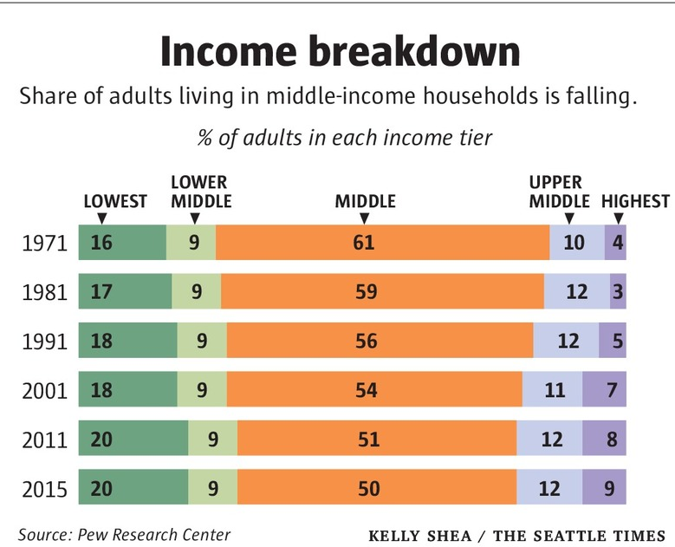
Inequality Can Directly Affect GDP
The US Economy is driven by consumption (67% of GDP).
Middle class are the big consumers.
They have less money.
Consumption is lower.
GDP is lower.

Slide 42
Tension in Policy Solutions
Is it possible to increase growth at the same time that you reduce income inequality?
Common refrain among some that government intervention in the economy is always and everywhere bad for growth.
Possibly: expanding equality of access promotes the full utilization of resources.
Expanding equality of access requires resources likely from the well-to-do.

Slide 43
Summary
Income inequality is clearly increasing.
The economy is clearly favoring owners of productive resources over labor.
The causes appear to be largely driven by:
The market – technology, competition, and trade
Changing institutions.
Open questions are:
To act or not to act?
If so, how?
The level of inequality is a policy choice.

Slide 44
Thank you!
Any Questions?
www.NEEDelegation.org
Roger White
rwhite1@whittier.edu
Contact NEED: info@needelegation.org
Submit a testimonial: www.NEEDelegation.org/testimonials.php
Become a Friend of NEED: www.NEEDelegation.org/friend.php

Slide 45
Available NEED Topics Include:
Coronavirus Economics
Climate Change
Economic Inequality
Economic Mobility
US Social Policy
Trade and Globalization
Minimum Wages
The U.S. Economy
Immigration Economics
Housing Policy
Federal Budgets
Federal Debt
Black-White Wealth Gap
Autonomous Vehicles

